Slide 1
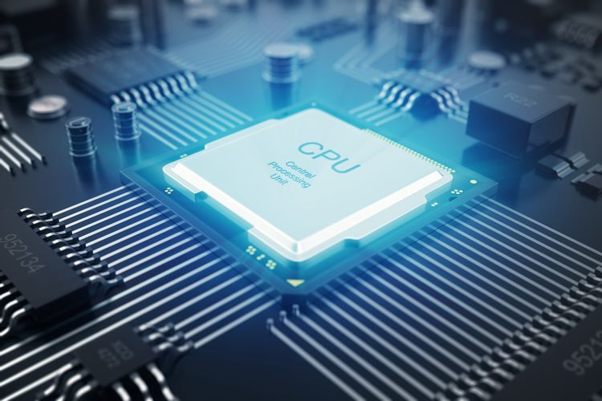
Central / Core
Processing
Unit
CPU

Slide 2
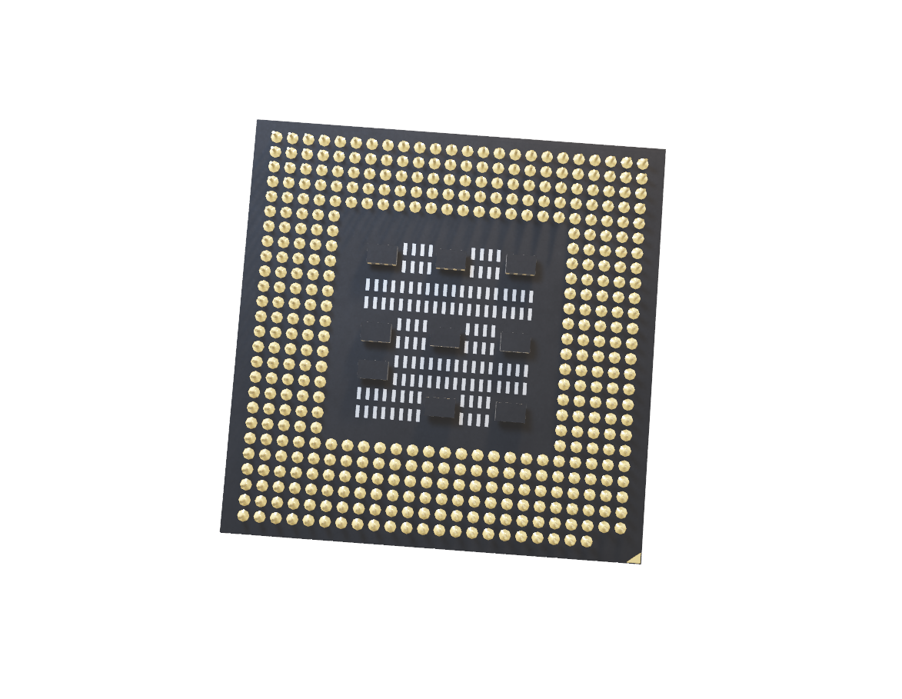
What
Is
A CPU?
The CPU is often called the brains of the computer. It is one of the several processing units, but arguably, the most essential. The CPU performs calculations, actions and running programs.

Slide 3
CPU Components

Slide 4
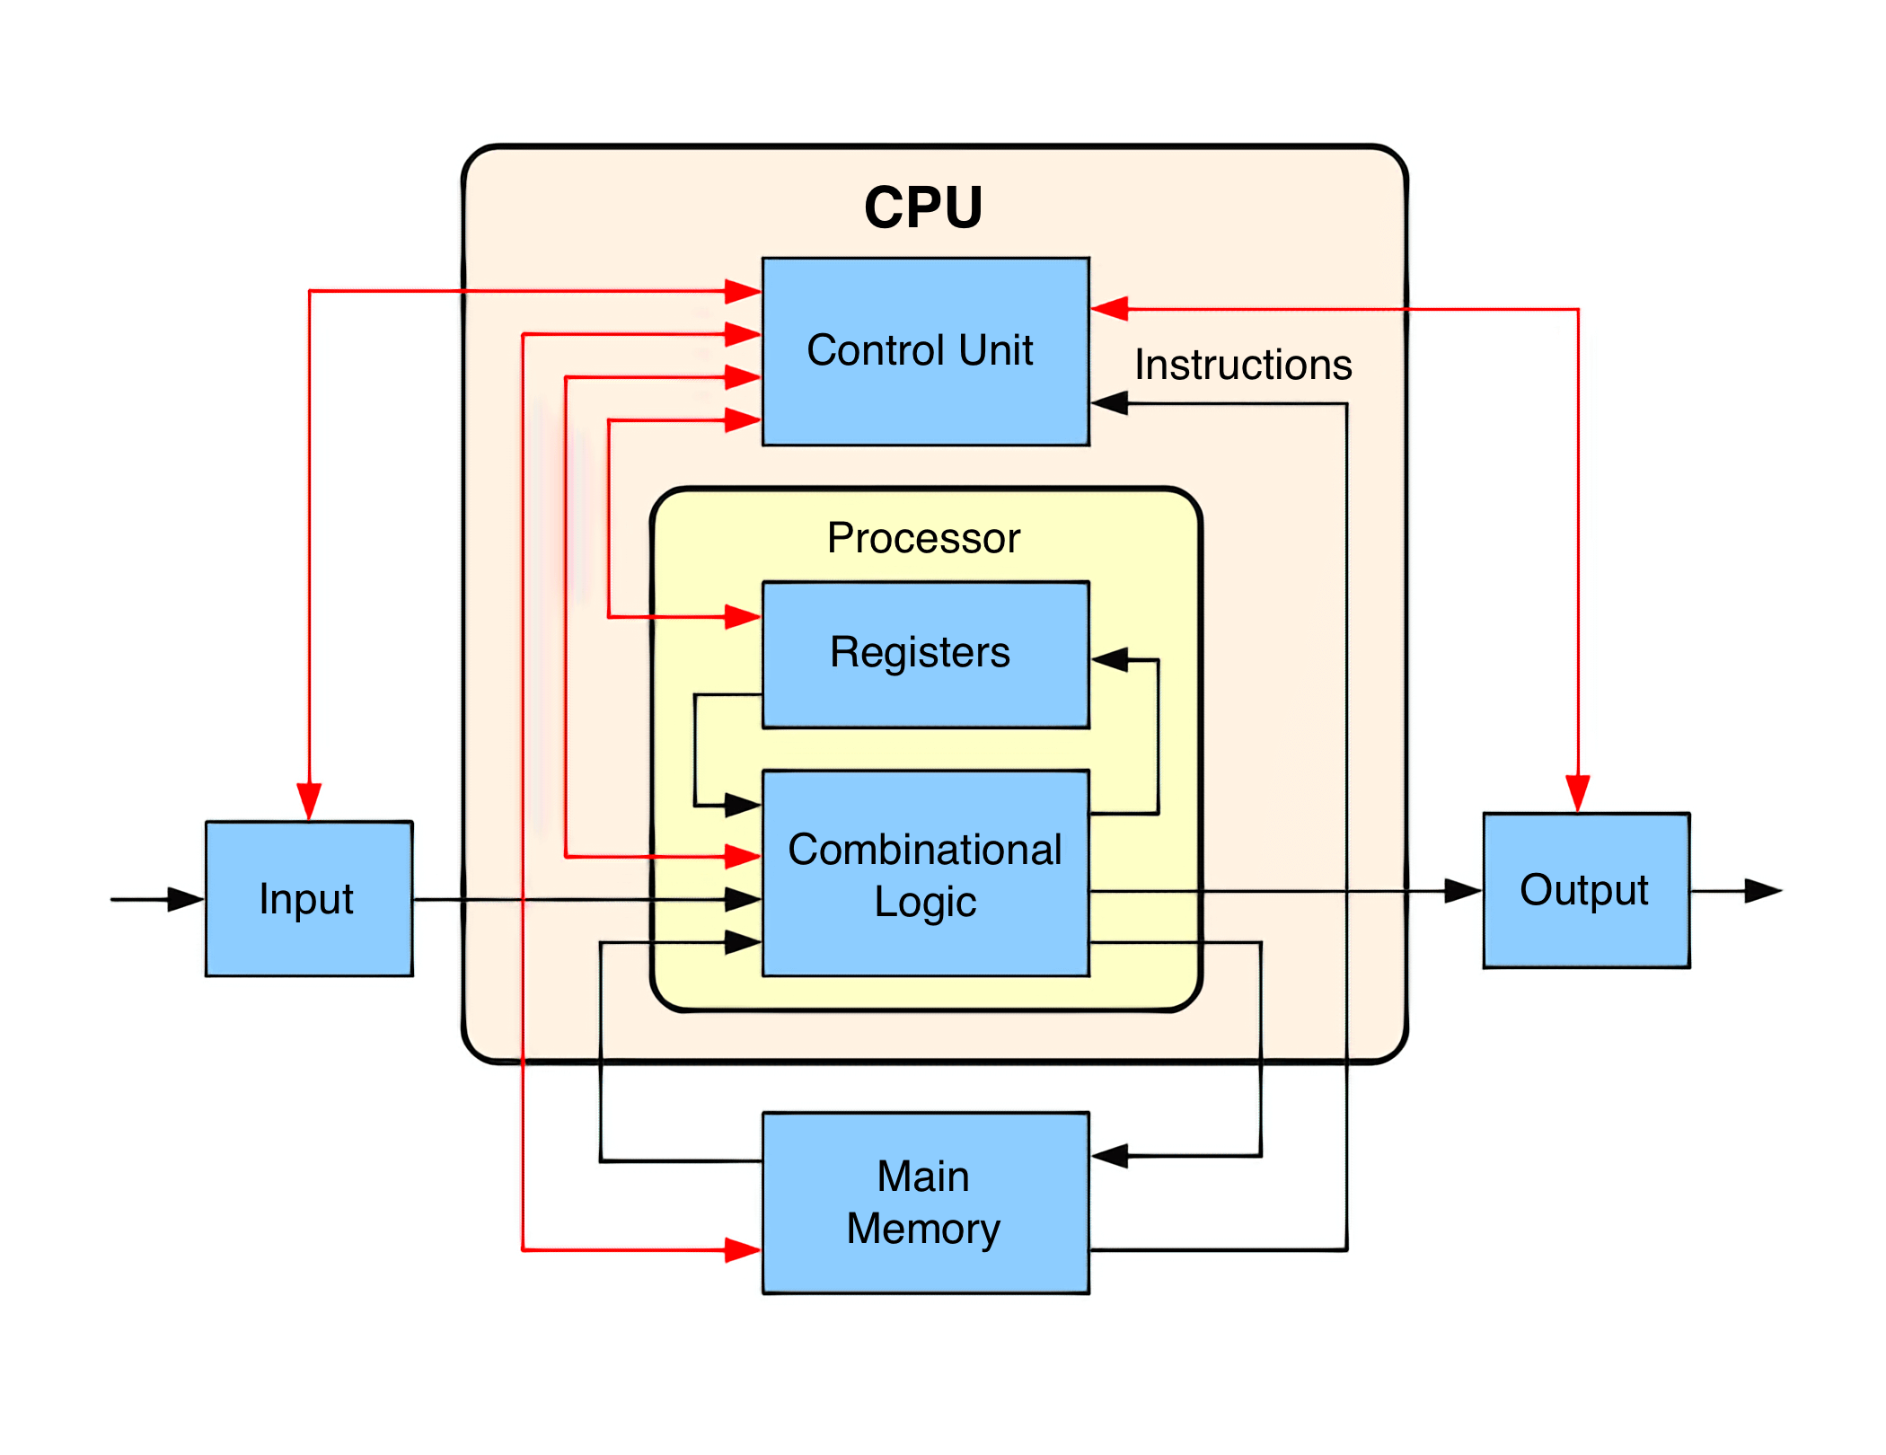
Control Unit
Executive part

Slide 5


Slide 6
Complier

Slide 7
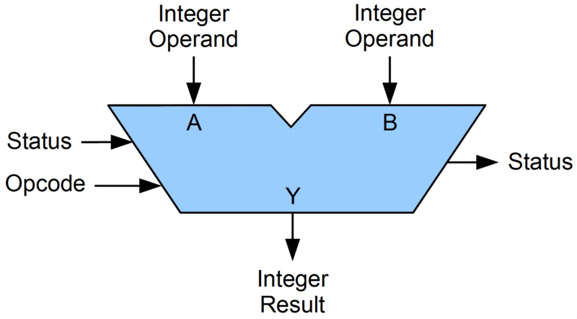
How
The ALU
works

Slide 8
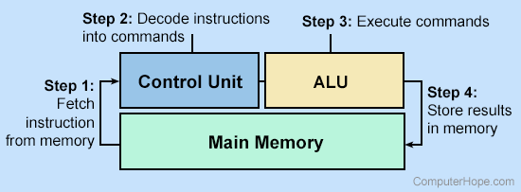
Machine Cycle

